Slide 1
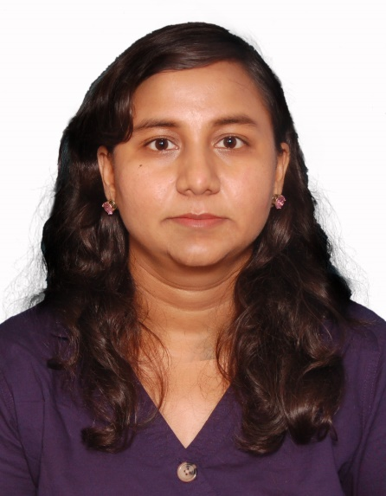
Dr. Alka Bhingardeo
Assistant Professor,
Department of Anatomy
AIIMS Bibinagar Telangana, India

Slide 2
Qualification & Experience
Course | Institution | Year | Duration
MBBS | Dr. SCGMC, Nanded | 2008 | 4 Years
MD Anatomy | TNMC, Mumbai | 2015 | 2 Years 10 mths
DNB Anatomy |  | 2016
Senior Resident | Seth GSMC& KEM Hospital, Mumbai | 2015-2016 | 1 Year
Senior Resident | HBTMC, Mumbai | Aug 2016-July 2019 | 3 Years
Assistant Professor | AIIMS Bibinagar | August 2019 –Till date | 7 mths

Slide 3
I was Called as Speaker in Second World Congress of Anatomy Rome Italy 2019

Slide 4
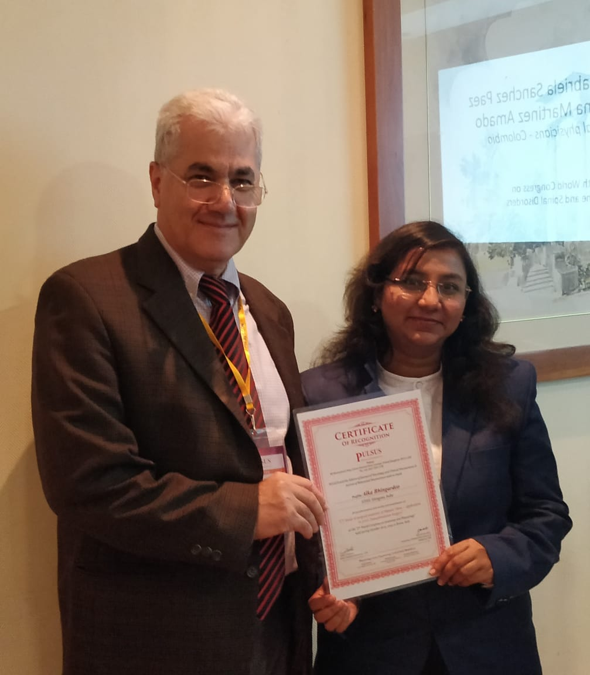
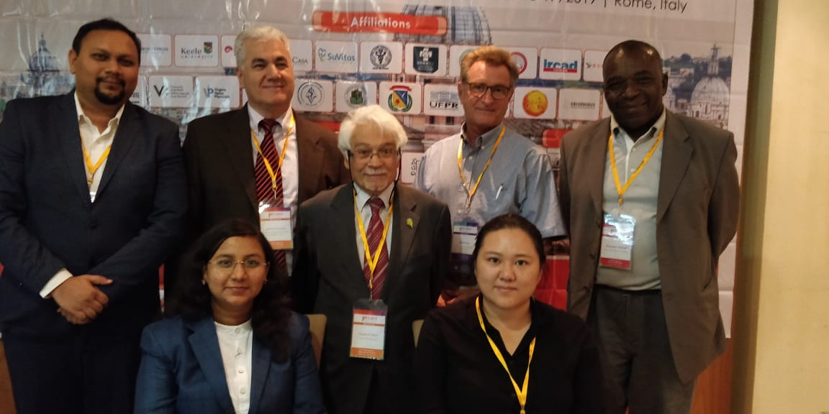
Second World Congress Of Anatomy 2019, Rome Italy
SPEAKER PANEL

Slide 5
Nature of work
Assistant Professor in Anatomy, AIIMS Bibinagar
Member of Research, Students welfare and Cultural Committee AIIMS Bibinagar
Hostel Superitendent Girl’s Hostel, AIIMS Bibinagar
Research & Publications – Total 9 Publications in International Journal
Teaching experience for MBBS, BDS, Occupational Therapy, Physiotherapy & Nursing students
Involvement of students in Research
30 Museum specimens in HBTMC, Mumbai
Gross models & Educational Videos

Slide 6
International Publications
Bhingardeo A V, Khambatta S. An anatomical evaluation of venous drainage of liver by multi-slice spiral computed tomography.International Journal of Recent Trends in Science and Technology.March2017;22(2):140-144
Bhingardeo A V, Khambatta S. CT study of surgical anatomy of hepatic veins - application in liver transplantation surgery.MedPulse-International Journal of Anatomy. March 2017;1(3):45-48
Bhingardeo A V, Bhoir M. Study of variations in the draining pattern of pulmonary veins in left atrium. MedPulse-International Journalof Anatomy. October 2018;8(1):05-07
Alka V Bhingardeo, Mehera Bhoir. An anatomical evaluation of variations in the terminal branching pattern of facial nerve. MedPulse-International Journal of Anatomy. May2019;10(2):45-49

Slide 7
International Publications
5) Alka Bhingardeo, Mehera Bhoir. Morphometric analysis of dry human mandibles -Application in inferior alveolar nerve block .July 2019:11(1):1-4
6) Bhingardeo A V, Khambatta S. Unilateral variant origin of first lumbrical. MedPulse-International Journal of Anatomy.February 2017;1(2):39-40
7) Bhingardeo A V, Bhoir M. Unilateral left pulmonary agenesis with the presence of bilateral accessory lobes of lung. MedPulse-International Journal of Anatomy. December 2018;8(3):32-34
8) Alka Bhingardeo, Mehera Bhoir, Tejas Shelar.Bilateral variations in the terminal branches of facial nerve- A case report.MedPulse - International Journal of Anatomy.February 2019;9(2):21-23
9) Bhingardeo A V, Bhoir M. Accessory spleen at hilum-Acase report. MedPulse - International Journal of Anatomy.July 2017;3(1):06-07

